Slide 1
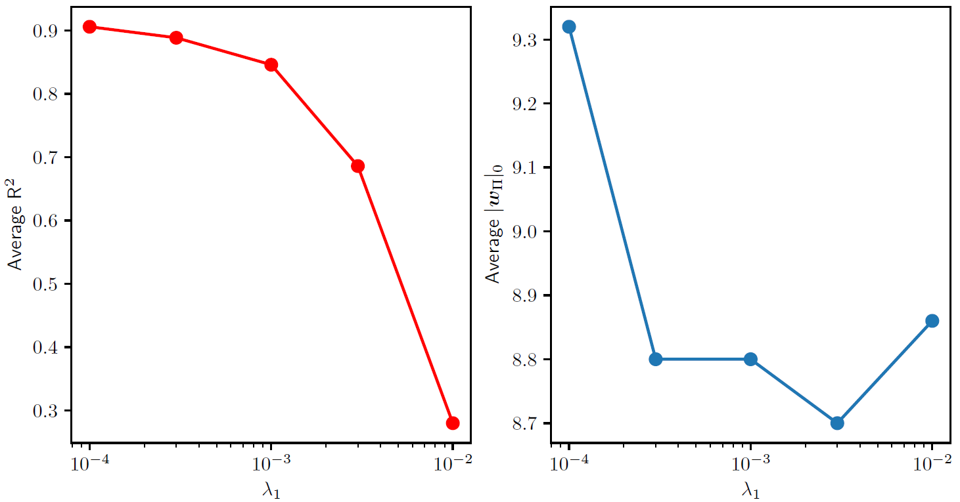
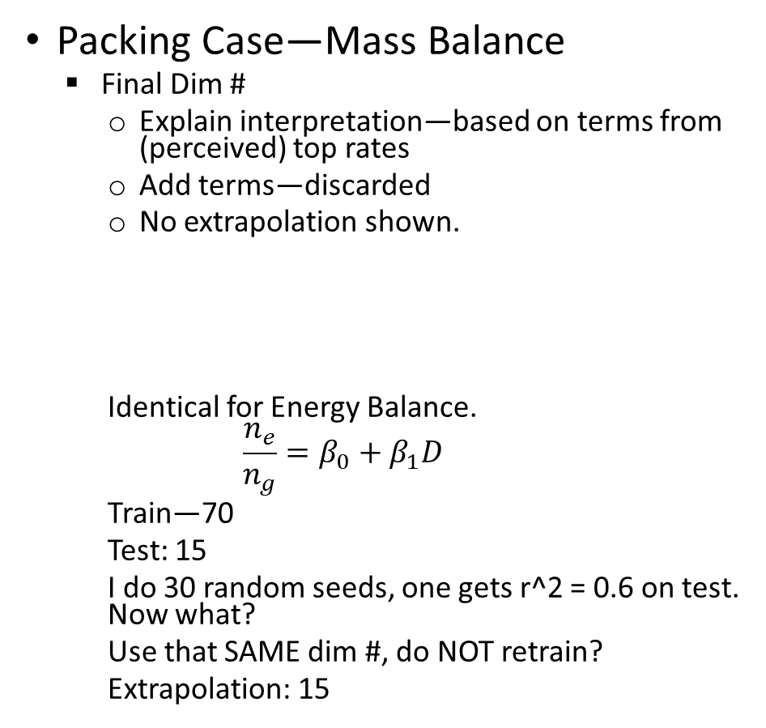
Original Paper
Packing Case—Mass Balance
Final Dim #
Explain interpretation—based on terms from (perceived) top rates
Add terms—discarded
No extrapolation shown.
Identical for Energy Balance.
$$\frac{n_{e}}{n_{g}}=β_{0}+β_{1}D$$
Train—70
Test: 15
I do 30 random seeds, one gets r^2 = 0.6 on test. Now what?
Use that SAME dim #, do NOT retrain?
Extrapolation: 15
Figures:
Lambda tuning--

Slide 2
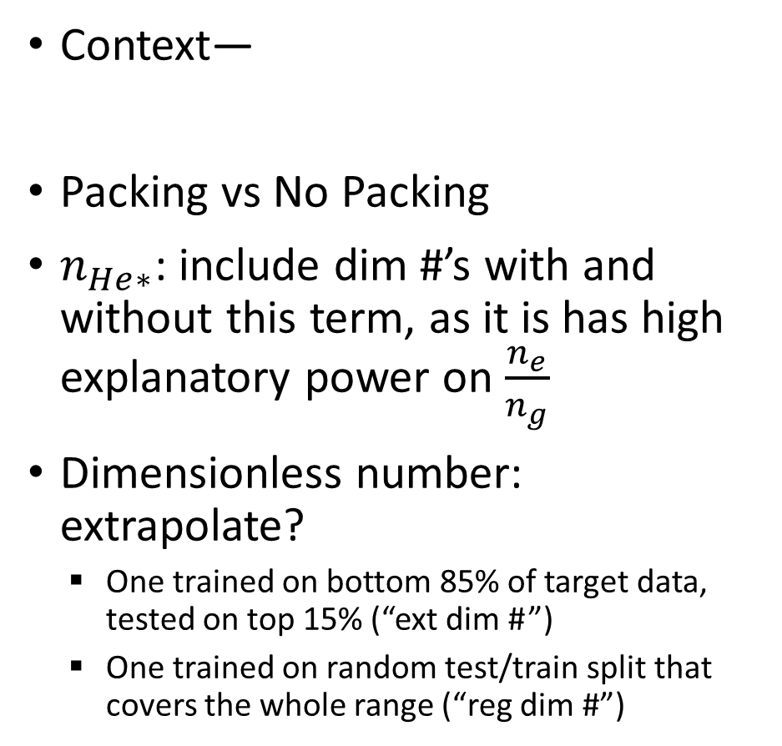
Current Work
Context—
Packing vs No Packing
$n_{He∗}$: include dim #’s with and without this term, as it is has high explanatory power on $\frac{n_{e}}{n_{g}}$
Dimensionless number: extrapolate?
One trained on bottom 85% of target data, tested on top 15% (“ext dim # ”)
One trained on random test/train split that covers the whole range (“reg dim #”)

Slide 3
Paper Presentation Order—Results
No Packing Case—Mass Balance
Final ‘reg dim #’ **
Explain interpretation, that n_{He*a} is highly informative
Derived from top 6/10 rates (remaining rates are negligible)
Dim # w/out n_{He*a}
Explain what terms it represents
Comparison: dimensionless # found that can extrapolate (trained on bottom 85% of target) vs dimensionless # found when training data is taken randomly (80/20 train/test split)
**Why not ‘ext dim #’?
Problem: r^2=0.5 makes for terrible parity plot
Argue: ‘reg dim#’ higher r^2 means it better captures the system behavior.
Figures:
Lambda tuning
On ‘reg dim #’ because
Easier to produce ‘reg dim #s’
Greater variability in r^2 in ‘reg dim #s’ vs ‘ext dim #s’.
Show mean r^2 vs # of included rates
Problem: unpacked case has very little data. Dimensionless numbers that “extrapolate” do a bad job and have a bad r^2.

Slide 4
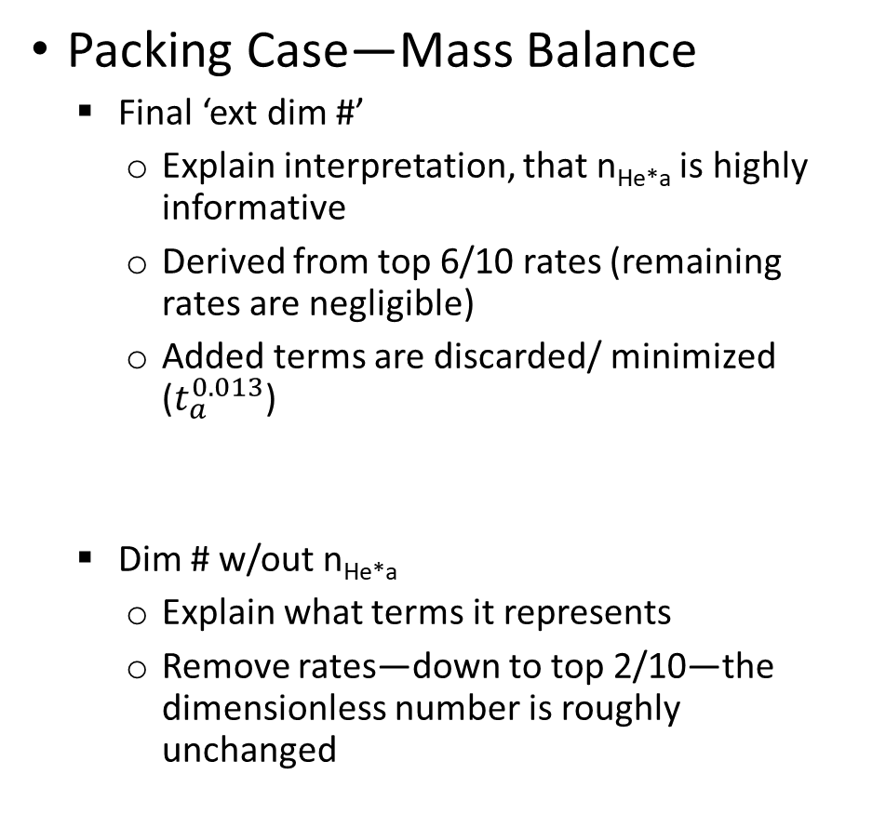
Paper Presentation Order—Results
Packing Case—Mass Balance
Final ‘ext dim #’
Explain interpretation, that n_{He*a} is highly informative
Derived from top 6/10 rates (remaining rates are negligible)
Added terms are discarded/ minimized ($t_{a}^{0.013}$)
Dim # w/out n_{He*a}
Explain what terms it represents
Remove rates—down to top 2/10—the dimensionless number is roughly unchanged
Figures:
‘Ext dim #’ extrapolation
For the packed case—good extrapolation
the dimensionless number is based on the top two terms if no n_{He*a} is included
Cannot converge for all terms—try multistart

Slide 5
SPACE

Slide 6
CONTEXT
Act as if we can measure everything
Use data-driven methods to find dimensionless relationship
We act as if we cannot see into the model, and hence we add terms we think are relevant

Slide 7
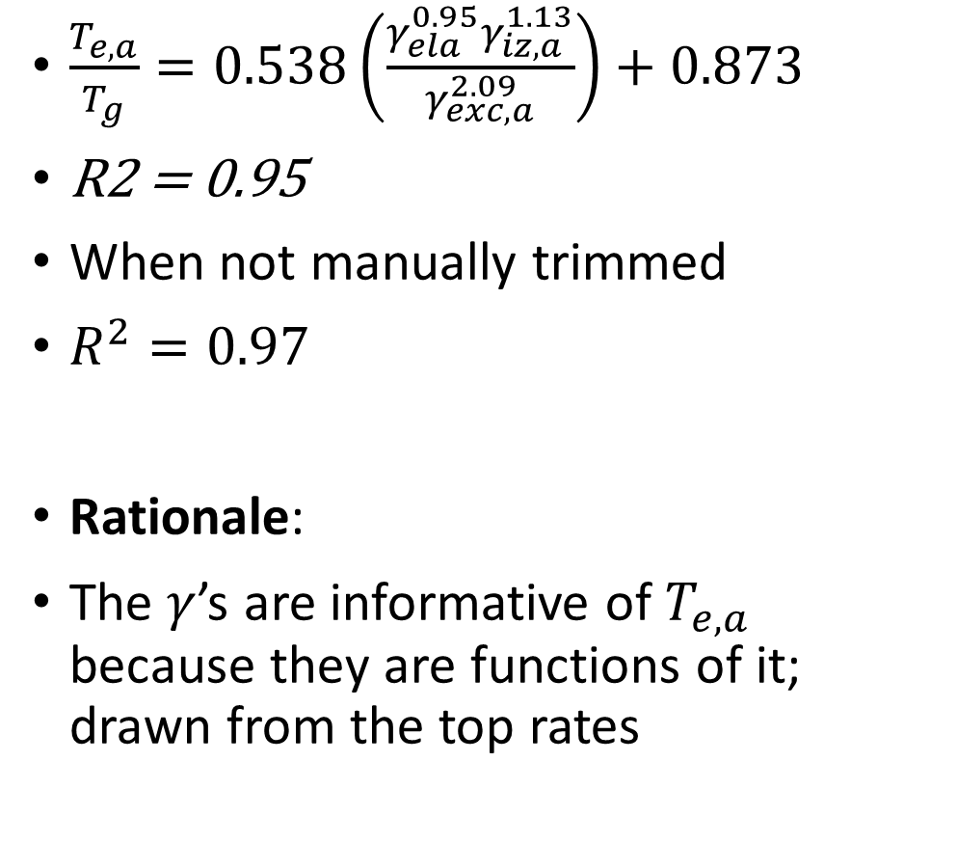
Packed Case—Energy Balance
$\frac{T_{e,a}}{T_{g}}=0.538\left(\frac{γ_{ela}^{0.95}γ_{iz,a}^{1.13}}{γ_{exc,a}^{2.09}}\right)+0.873$
R2 = 0.95
When not manually trimmed
$R^{2}=0.97$
Rationale:
The $γ$’s are informative of $T_{e,a}$ because they are functions of it; drawn from the top rates
Top Rates—EB packed
E_in: E
ta ionization: n_e n_g V K_iz,a E_iz ta
tb elastic: n_g n_g V K_ela E_ela tb
ta excitation: n_g n_g V K_exc,a E_exc ta
ta elastic: n_e n_g V K_ela,a E_ela,a ta
tb floating loss: ne exp(-1/2) u_B e_c (5/2) T_e A_tot t_b
ta floating loss: ne exp(-1/2_ u_B_a _c (5/2) T_e_a A_tot t_a

Slide 8
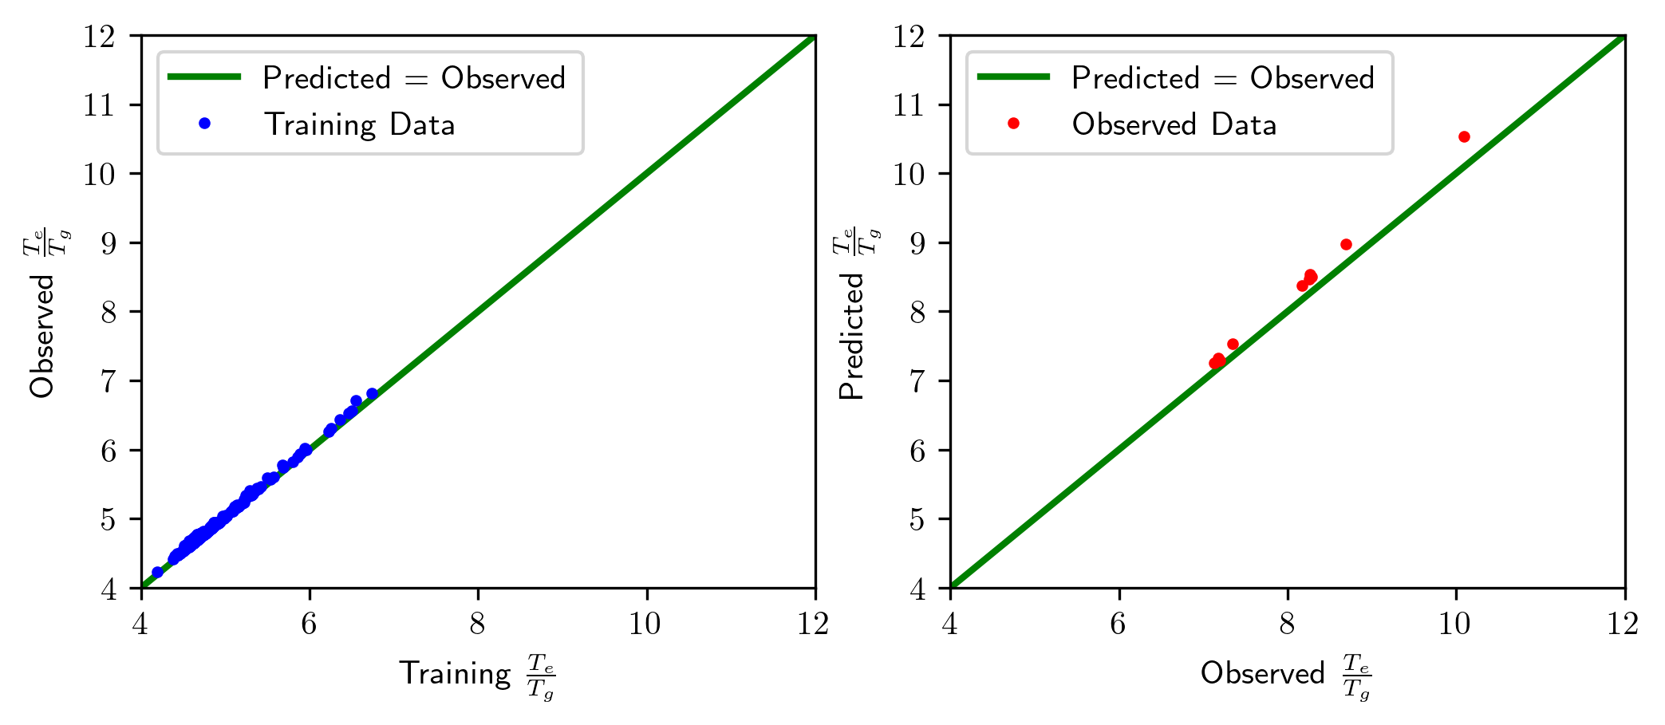
Packed Case—Energy Balance
Top Rates—EB packed
E_in: E
ta ionization: n_e n_g V K_iz,a E_iz ta
tb elastic: n_g n_g V K_ela E_ela tb
ta excitation: n_g n_g V K_exc,a E_exc ta
ta elastic: n_e n_g V K_ela,a E_ela,a ta
tb floating loss: ne exp(-1/2) u_B e_c (5/2) T_e A_tot t_b
ta floating loss: ne exp(-1/2_ u_B_a _c (5/2) T_e_a A_tot t_a

Slide 9
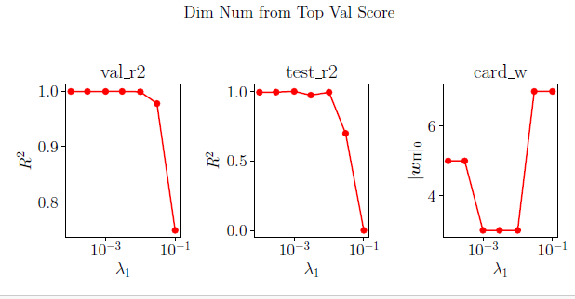
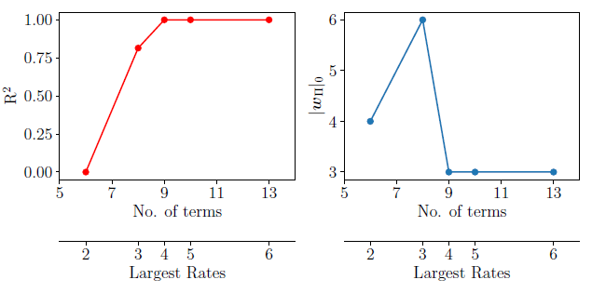
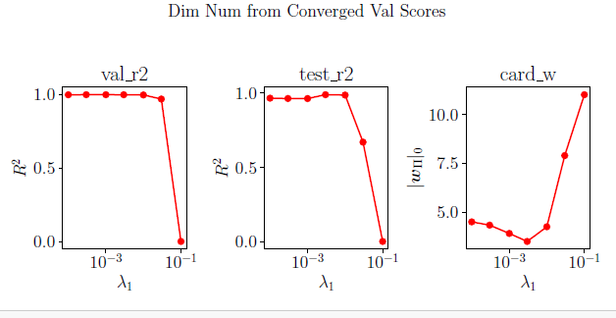
Packed Case—Energy Balance

Slide 10
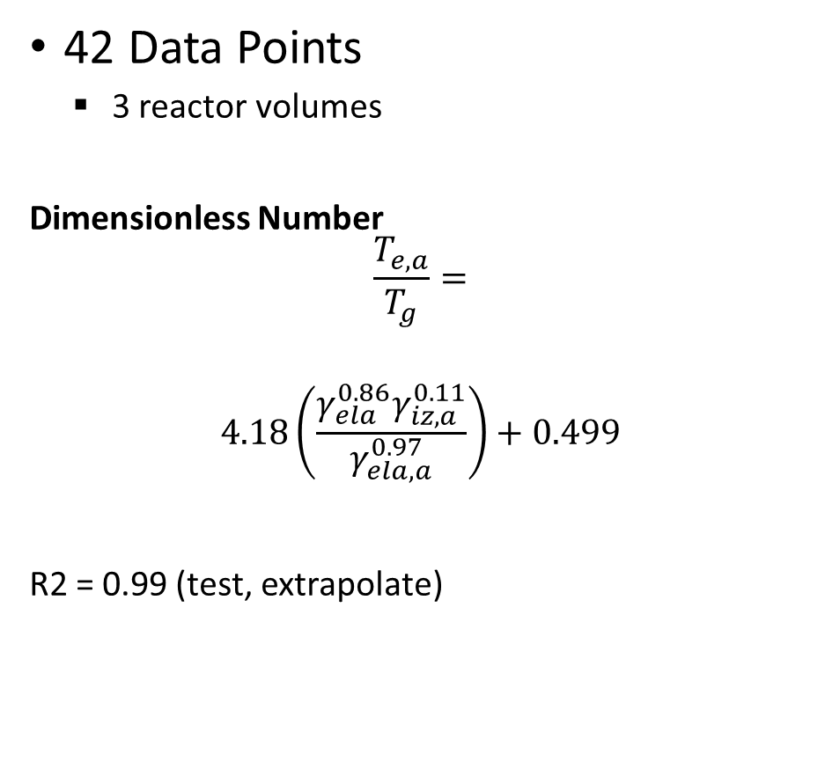
Unpacked Case—Energy Balance
Top Rates—EB unpacked
E_in: E
tb_elastic: n_e * n_g V * K_ela * E_ela * t_b
ta_excitation: n_e * n_g* V* K_exc,a * E_exc * t_a
ta_ionization: n_e * n_g * V * K_iz,a * E_iz * t_a
ta_elastic: n_e * n_g * V * K_ela,a *E_ela,a * t_a
tb_ion loss_electrode_a: n_sa * u_B * A_a * t_b * e_c * (1/2 T_e + V_p, tb)
ta_electron_loss_electrode_a: -1/4 * n_sa * A_a * e_c * (-2 * Te, a) * t_a * v_e,a
42 Data Points
3 reactor volumes
Dimensionless Number
$$\frac{T_{e,a}}{T_{g}}=$$
$$4.18\left(\frac{γ_{ela}^{0.86}γ_{iz,a}^{0.11}}{γ_{ela,a}^{0.97}}\right)+0.499$$
R2 = 0.99 (test, extrapolate)
Notes:
Consider redoing if a new optimal lambda is found in the lambda tuning for EB.

Slide 11
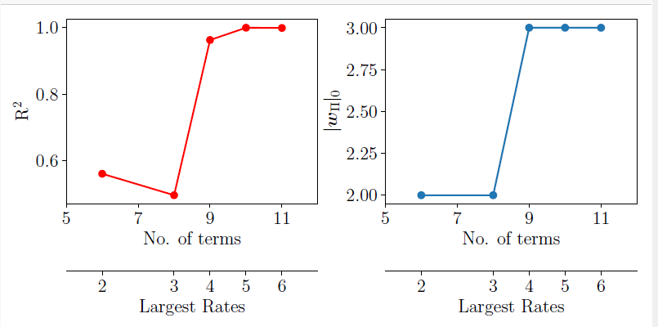
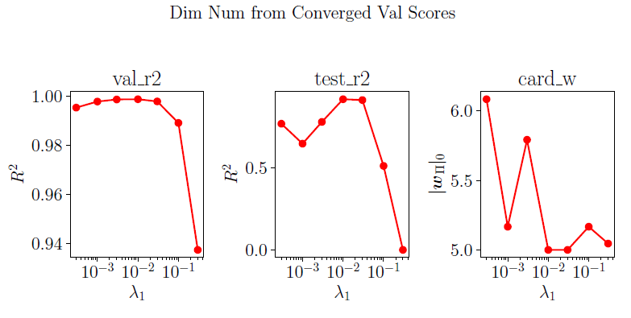
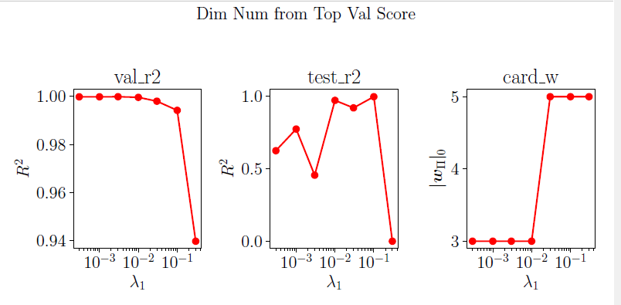
Unpacked Case—Energy Balance
Notes:
Consider redoing if a new optimal lambda is found in the lambda tuning for EB.

Slide 12
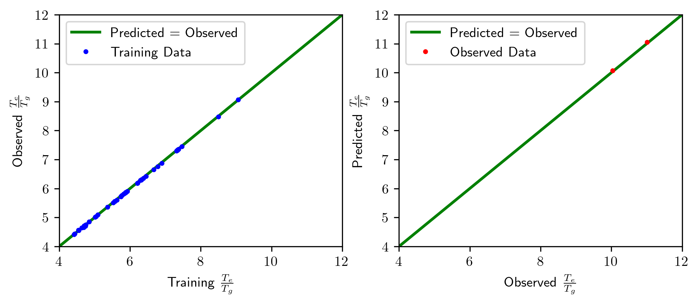
Unpacked Case—Energy Balance
Notes:
Consider redoing if a new optimal lambda is found in the lambda tuning for EB.

Slide 13
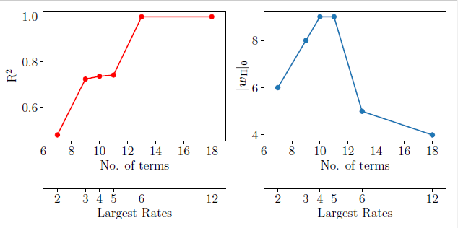
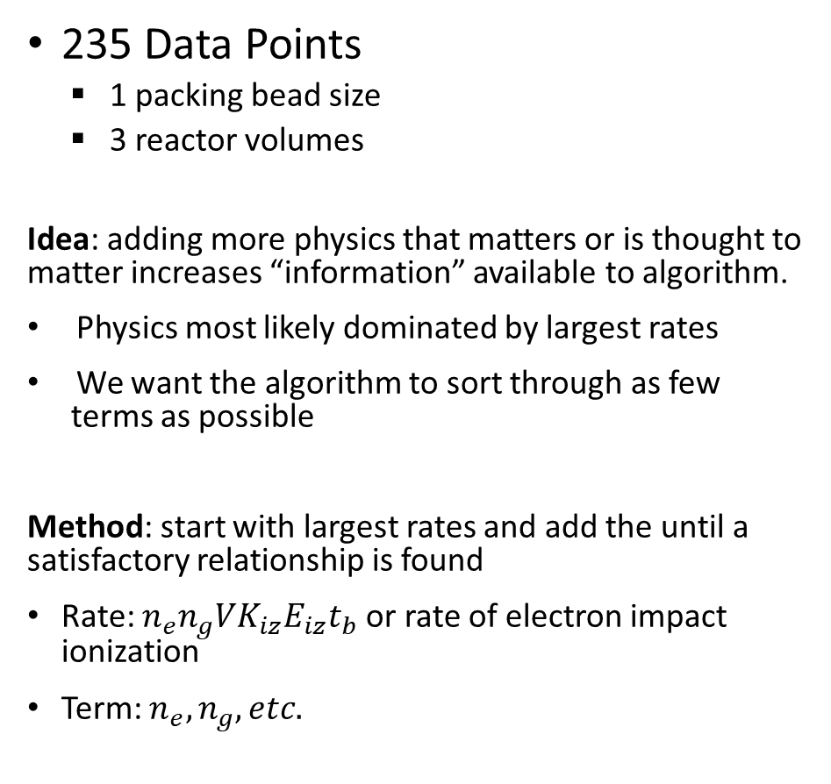
Packed Case—Mass Balance
235 Data Points
1 packing bead size
3 reactor volumes
Idea: adding more physics that matters or is thought to matter increases “information” available to algorithm.
Physics most likely dominated by largest rates
We want the algorithm to sort through as few terms as possible
Method: start with largest rates and add the until a satisfactory relationship is found
Rate: $n_{e}n_{g}VK_{iz}E_{iz}t_{b}$ or rate of electron impact ionization
Term: $n_{e}, n_{g}, etc.$
25 random seeds for each point except final
Two rates already capture sizable fraction of physics
Increasing terms lets discovered dimensionless number become more accurate….as it adds terms
Find critical terms, and size drops.
As we add even more terms, the loss landscape is harder to navigate, harder to trim terms. Took >100 random seeds to get good convergence.

Slide 14
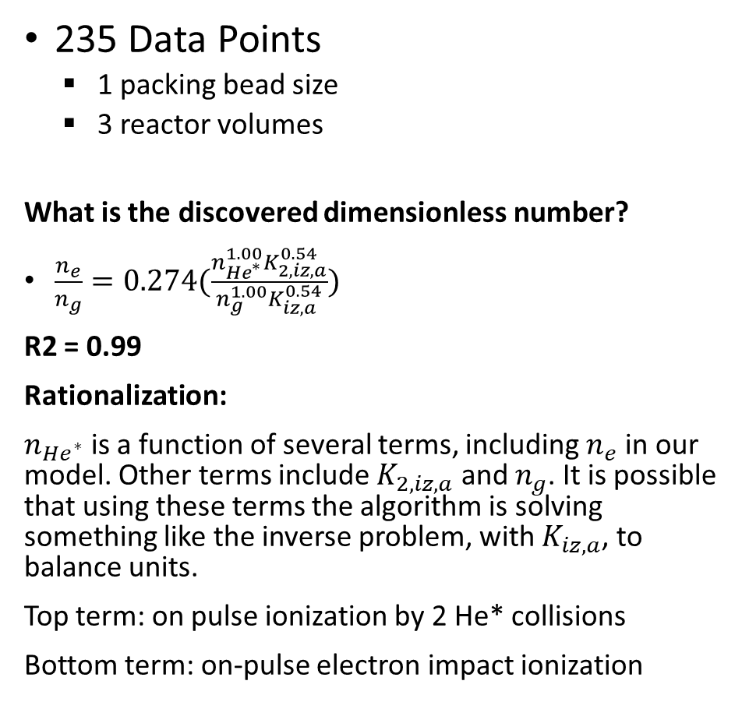
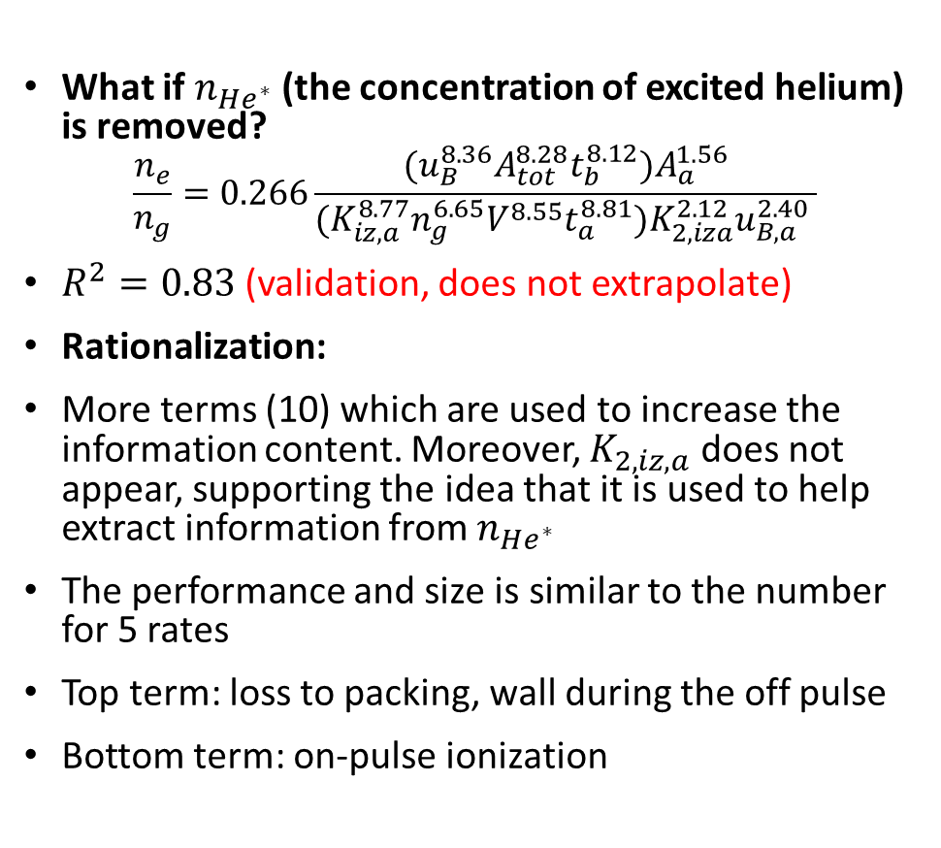
Packed Case—Mass Balance
235 Data Points
1 packing bead size
3 reactor volumes
What is the discovered dimensionless number?
$\frac{n_{e}}{n_{g}}=0.274(\frac{n_{He^{∗}}^{1.00}K_{2,iz,a}^{0.54}}{n_{g}^{1.00}K_{iz,a}^{0.54}})$
R2 = 0.99
Rationalization:
$n_{He^{∗}}$ is a function of several terms, including $n_{e}$ in our model. Other terms include $K_{2,iz,a}$ and $n_{g}$. It is possible that using these terms the algorithm is solving something like the inverse problem, with $K_{iz,a}$, to balance units.
Top term: on pulse ionization by 2 He* collisions
Bottom term: on-pulse electron impact ionization
What if $n_{He^{∗}}$ (the concentration of excited helium) is removed?
$$\frac{n_{e}}{n_{g}}=0.266\frac{(u_{B}^{8.36}A_{tot}^{8.28}t_{b}^{8.12})A_{a}^{1.56}}{{(K}_{iz,a}^{8.77}n_{g}^{6.65}V^{8.55}t_{a}^{8.81})K_{2,iza}^{2.12}u_{B,a}^{2.40} }$$
$R^{2}=0.83$ (validation, does not extrapolate)
Rationalization:
More terms (10) which are used to increase the information content. Moreover, $K_{2,iz,a}$ does not appear, supporting the idea that it is used to help extract information from $n_{He^{∗}}$
The performance and size is similar to the number for 5 rates
Top term: loss to packing, wall during the off pulse
Bottom term: on-pulse ionization

Slide 15
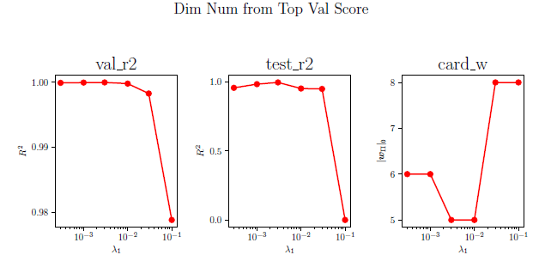
Packed Case—Mass Balance
235 Data Points
1 packing bead size
3 reactor volumes
Idea: we can tune the trade-off between performance and interpretability by encouraging small dimensionless numbers (using LASSO to provide a Laplacian Prior)
Method: take good fit ( 6 terms) and see how lambda-tuning influences the discovery
25 random seeds for each point except final
Increasing \lambda (the penalty on size) drops the dimensionless number
Optimum available. Beyond this point, the penalty begins to drop the fit as well

Slide 16
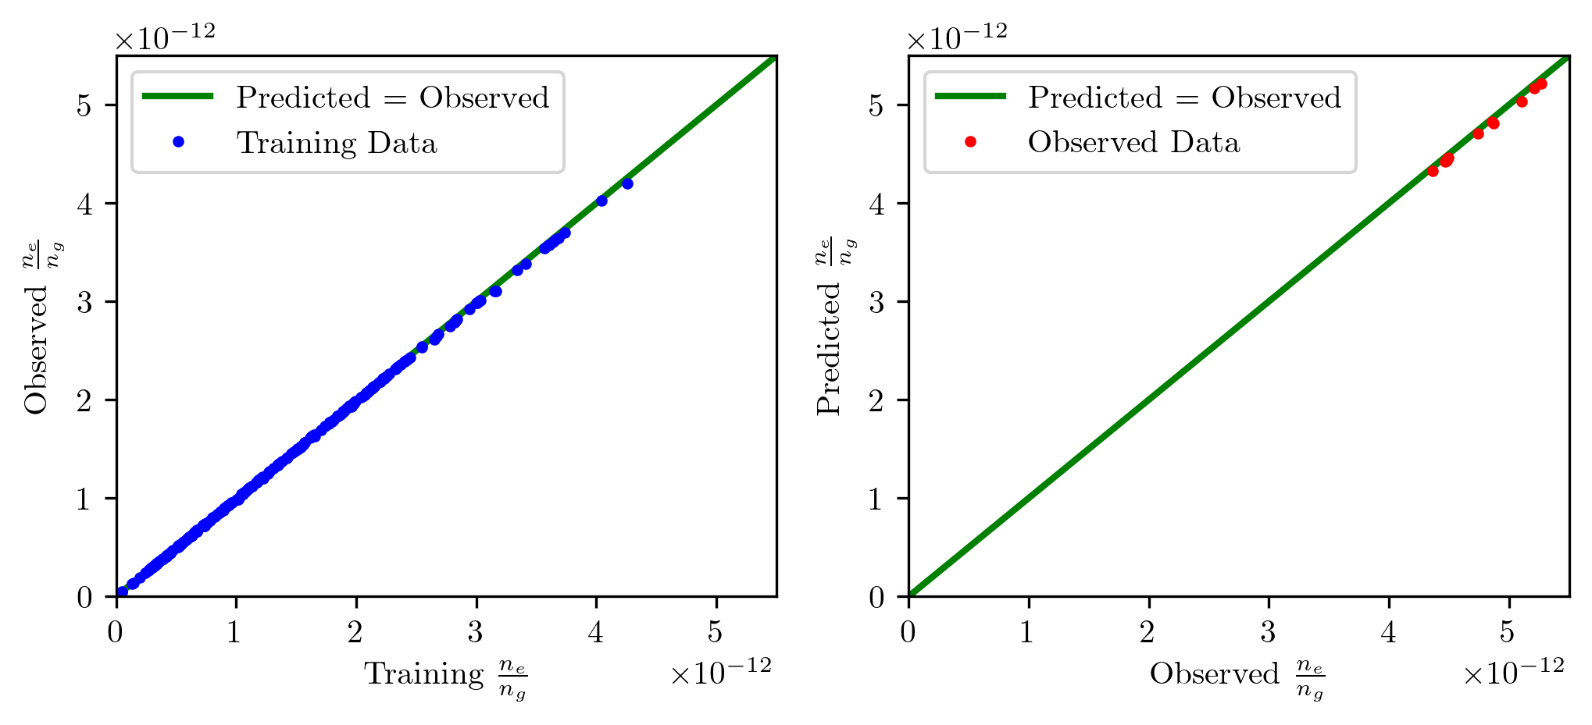
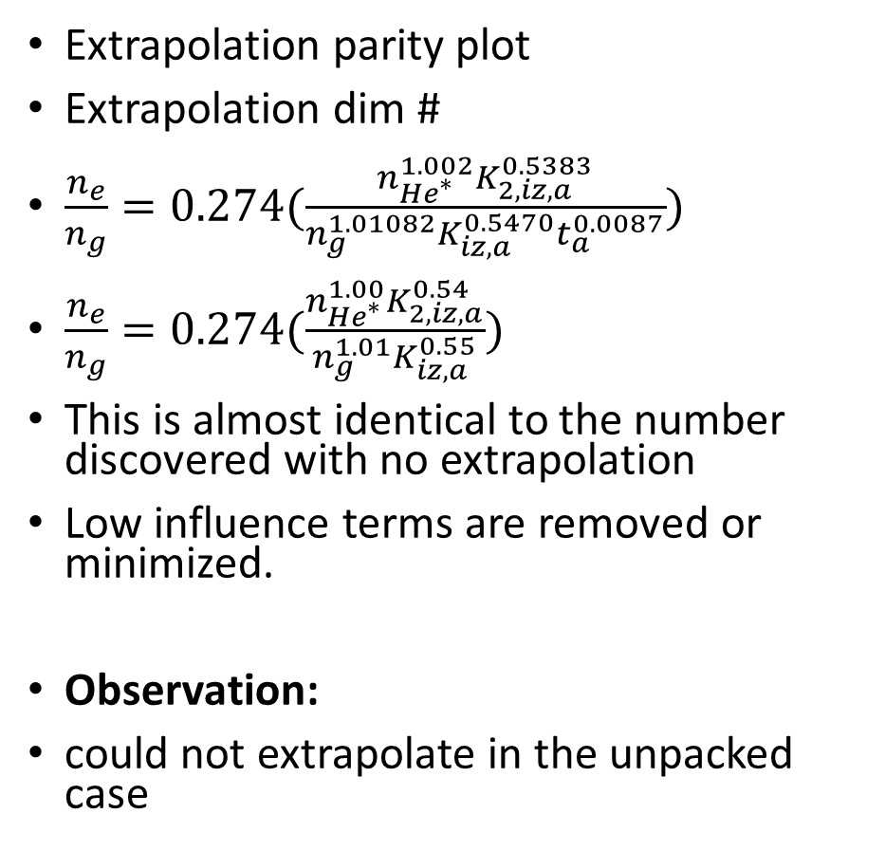
Packed Case – Mass Balance
Extrapolation parity plot
Extrapolation dim #
$\frac{n_{e}}{n_{g}}=0.274(\frac{n_{He^{∗}}^{1.002}K_{2,iz,a}^{0.5383}}{n_{g}^{1.01082}K_{iz,a}^{0.5470}t_{a}^{0.0087}})$
$\frac{n_{e}}{n_{g}}=0.274(\frac{n_{He^{∗}}^{1.00}K_{2,iz,a}^{0.54}}{n_{g}^{1.01}K_{iz,a}^{0.55}})$
This is almost identical to the number discovered with no extrapolation
Low influence terms are removed or minimized.
Observation:
could not extrapolate in the unpacked case

Slide 17
Key Takeaways
Can extrapolate:
EB-unpacked
MB-packed
EB-packed
Next steps:
Use only the extrapolating dim #
Redo plots, ignore unpacked MB case which failed to extrapolate
Be up front about what makes a good dim #
Performance
Pithy
Extrapolate (covers range of applicable physics)
Positioning the work:
Used measurement to feed into model
Can rationalize dim #’s on basis of model
Truncate dim #’s and see extrapolation performance. Desire: report rounded numbers\
Indefinite hold: regression with polynomial terms , not dimensionless

Slide 18
Comparison—regression, MB, packed?

Slide 19
Other
MOBO—Kimberly
While she worked on the control problem, I did some planning for the UV-Vis. After some literature review, had a suggestion that worked well in literature. For PAW, best to read in high UV range (190-250).
Want to measure: nitrite, nitrate
Issue:
O2 concentration matters in this range. Must explicitly account for it. How? Can’t just sprinkle oxygen into water. Avoid carbonic acid.
Hydrogen peroxide is UV active in this range
H2O2 and HNO2 spectra are pH dependent in this range

Slide 20
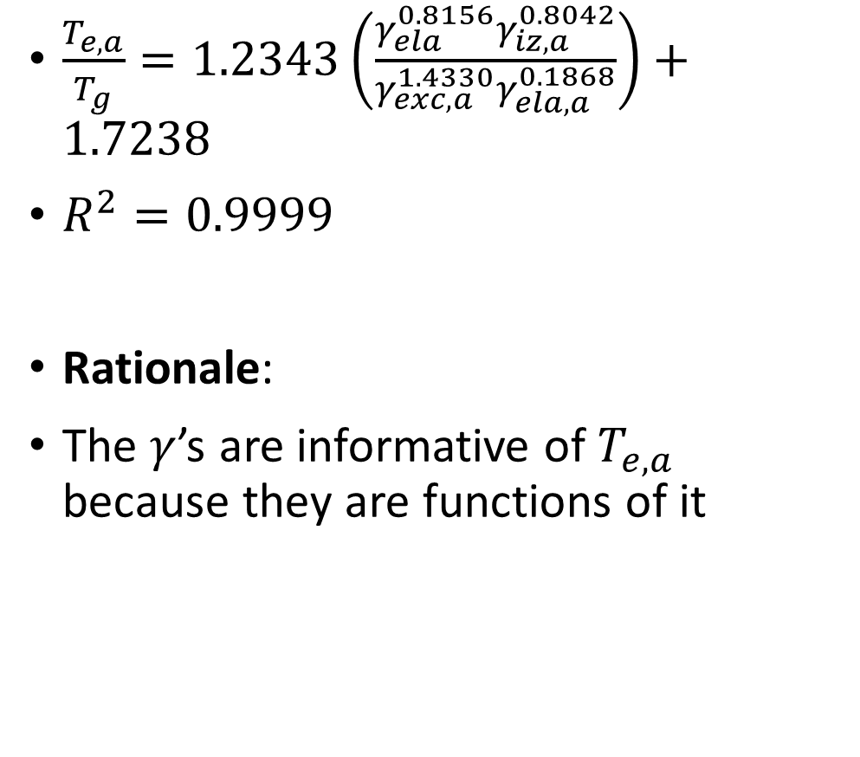
Packed Case—Energy Balance
$\frac{T_{e,a}}{T_{g}}=1.2343\left(\frac{γ_{ela}^{0.8156}γ_{iz,a}^{0.8042}}{γ_{exc,a}^{1.4330}γ_{ela,a}^{0.1868}}\right)+1.7238$
$R^{2}=0.9999$
Rationale:
The $γ$’s are informative of $T_{e,a}$ because they are functions of it
Top Rates—EB packed
E_in: E
ta ionization: n_e n_g V K_iz,a E_iz ta
tb elastic: n_g n_g V K_ela E_ela tb
ta excitation: n_g n_g V K_exc,a E_exc ta
ta elastic: n_e n_g V K_ela,a E_ela,a ta
tb floating loss: ne exp(-1/2) u_B e_c (5/2) T_e A_tot t_b
ta floating loss: ne exp(-1/2_ u_B_a _c (5/2) T_e_a A_tot t_a

Slide 21
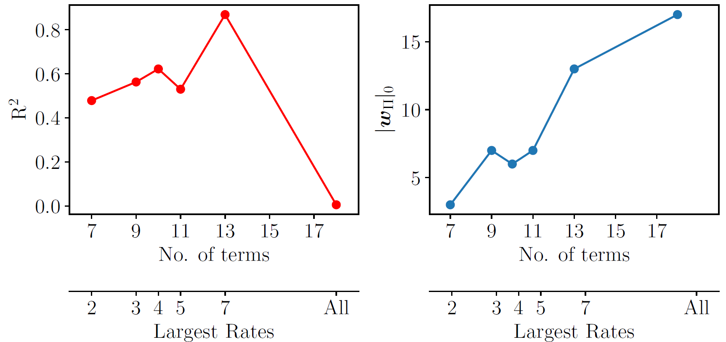
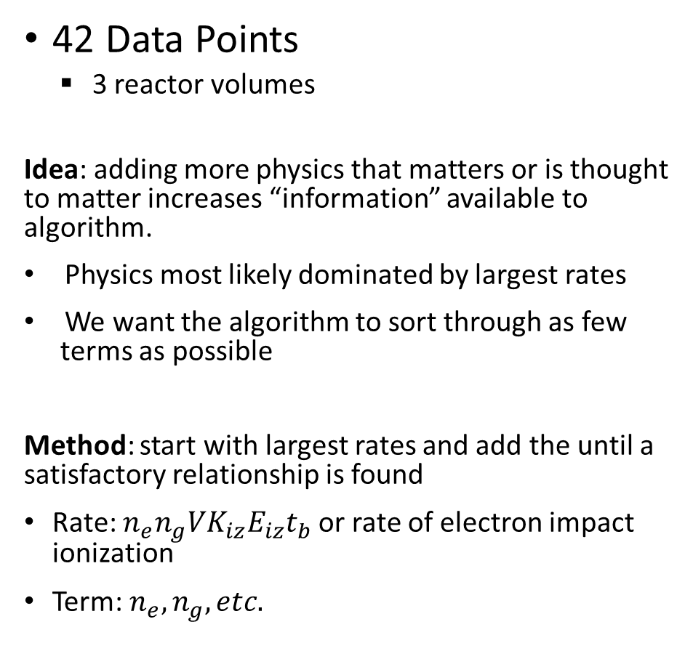
Unpacked Case—Mass Balance
42 Data Points
3 reactor volumes
Idea: adding more physics that matters or is thought to matter increases “information” available to algorithm.
Physics most likely dominated by largest rates
We want the algorithm to sort through as few terms as possible
Method: start with largest rates and add the until a satisfactory relationship is found
Rate: $n_{e}n_{g}VK_{iz}E_{iz}t_{b}$ or rate of electron impact ionization
Term: $n_{e}, n_{g}, etc.$
Lambda = 0.003
25 random seeds for each point except final
Two rates already capture sizable fraction of physics
Increasing terms lets discovered dimensionless number become more accurate….as it adds terms
Find critical terms, and size drops.
As we add even more terms, the loss landscape is harder to navigate, harder to trim terms. No convergence for >300 random seeds

Slide 22
Unpacked Case—Mass Balance
42 Data Points
3 reactor volumes
I have data on plotting vs lambda. Did not plot.

Slide 23
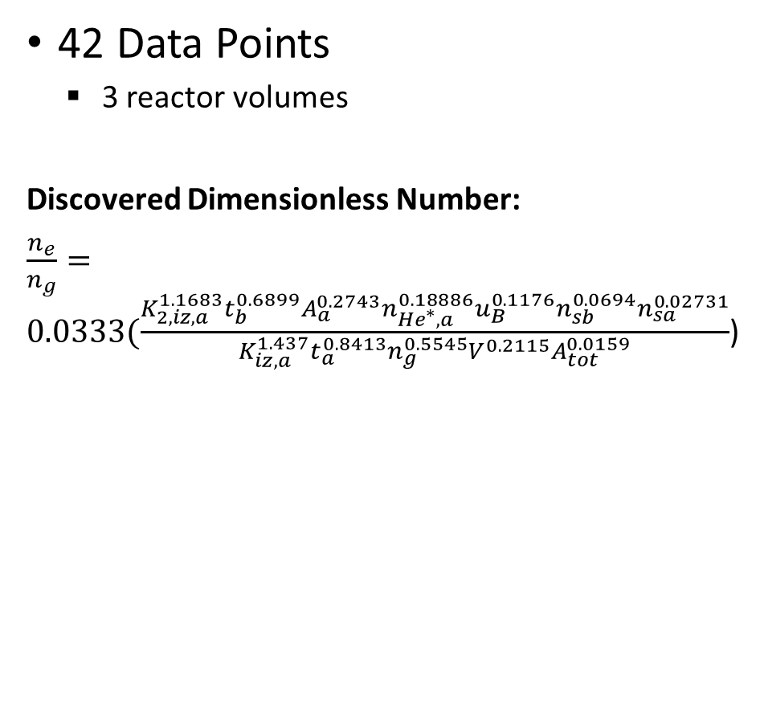
Unpacked Case—Mass Balance
Rates:
Volumetric ionization ta, K_iz_a * n_e * n_g * *t_a *V
Wall Loss tb: n_e * u_B * t_b * A_tot
Tb loss to electrode a: n_sa * A_a * u_B * t_b
Tb loss to electrode b: n_sb * A_a * u_B * t_b
Ta loss electrode a: A_a * n_sa * u_B_a * t_a
Ta_packing_wall_loss: n_e*exp(-1/2)*u_B_a*A_tot*t_a
Ta_vol_double_he_exc_ion: Volume*(n_He_exc_a**2)*K_2_iz_a*t_a
42 Data Points
3 reactor volumes
Discovered Dimensionless Number:
$\frac{n_{e}}{n_{g}}=0.0333(\frac{{K_{2,iz,a}^{1.1683}t}_{b}^{0.6899}A_{a}^{0.2743}n_{He^{∗},a}^{0.18886}u_{B}^{0.1176}n_{sb}^{0.0694}n_{sa}^{0.02731}}{K_{iz,a}^{1.437}t_{a}^{0.8413}n_{g}^{0.5545}V^{0.2115}A_{tot}^{0.0159}}$)

